Slide 1
Charity Law Association of Australia and New Zealand
2 August 2018
Murray Baird
Assistant Commissioner, General Counsel
Australian Charities and Not-for-profits Commission murray.baird@acnc.gov.au
Housing innovation
What’s charitable and what’s not?

Slide 2
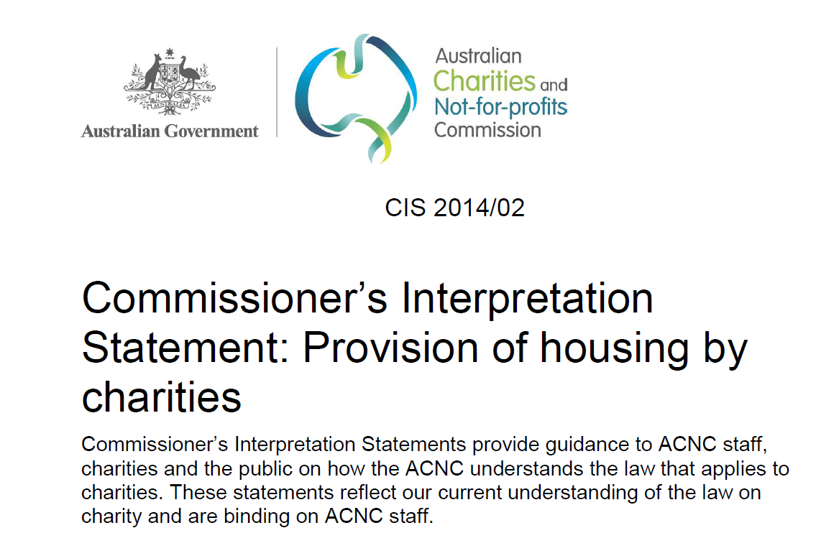

Slide 3
When is provision of housing charitable?
Provision of housing on a not for profit basis;
Within recognised charitable purposes – health, welfare, relief of poverty and disadvantage;
Poverty is not destitution – inability to attain a modest standard of living;
Commercial activities as a means to an end are OK

Slide 4
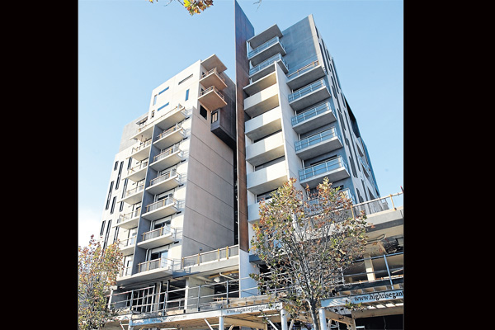
The main issues:
What charitable purposes are fulfilled in provision of housing?
To whom can charitable housing be provided?
What kinds of housing can be provided?
How does commercial activity fit in?
How much government involvement can there be?

Slide 5

The 3 Ps of Charitable Housing
Purpose Purpose Purpose

Slide 6

The three Qs of Charitable Housing
Do we have a Charitable Purpose?
Do we have a Benevolent Purpose?
Does everything we do contribute to that purpose? (Independent or Ancillary)

Slide 7

New Zealand
Queenstown Lakes Community Housing Trust
“Housing for those who contribute to the well being of the district”
Caps on income$86K for singles and $122K for 4 person households
Not poverty; not a disadvantaged area; too much individual benefit.
“whilst housing is a basic need, and right, home ownership [or location] is not”

Slide 8
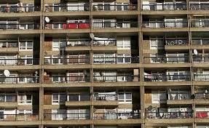
England
Helena Partnerships [2012]
Rental of Community Housing; Refurbishment of Council housing; any other work of a social landlord
Independent objects – not all charitable
Some tenants were not in need;
Benefit to individuals in tenancy is outweighed benefit to public unless there is a recognised charitable purpose – poverty relief or purpose to which private benefit is subordinate;

Slide 9

Australia
Common Equity Housing Limited v. Commissioner of State Revenue [1996]
Modest Dwellings to Eligible households
Relief of Poverty and Purposes beneficial to Community;
“Securing rental accommodation at low cost”
Triton and Tasmanian Electronic – “private benefit as a means to a broader purpose”

Slide 10
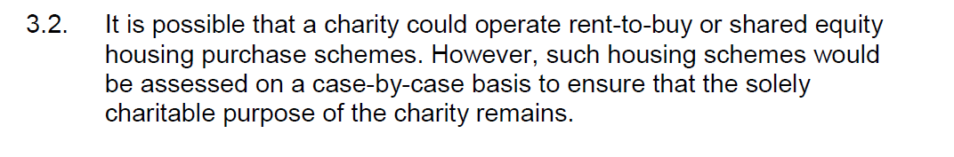
Rent or Buy?
ACNC CIS 2014/2
“Providing assistance to purchase a dwelling [is arguably] relieving poverty.”
Dal Pont Law of Charity 2nd ed. 8.12
“the ambition for home ownership is a foundation for good citizenship” and “awakens hope for a more stable and happier life”
Delmo Housing Corporation v. Finnegan (1949)85 F Supp220 @223

Slide 11
England and Wales
Garfield Poverty Trust (1990) – low or interest free loans to assist poor young exclusive brethren to purchase housing;
Habitat for Humanity (1994) - housing loans for 20 years whilst family was still in need was charitable;
Joseph Rowntree v. AG [1983]: sale of self contained units to elderly people on favourable terms was charitable despite private profit of capital gain.

Slide 12
Arguments against loans for ownership as Charitable
Objection: There might eventually be a capital gain Response: gain was incidental to housing and not a loss to the charity;
Objection: benefit not commensurate with need
Response: charity was providing accommodation – the method was irrelevant.
Objection: benefit might continue beyond poverty
Response: low interest loans could be called in if no longer needed.

Slide 13
A possible scenario
Assistance to own a home may be charitable;
The charitable purpose must be clear;
The charitable need best relieved by ownership;
Private benefit proportionate to need.

Slide 14
Thank you.
www.acnc.gov.au/contact
Phone: Call 13 ACNC (13 22 62) weekdays 9am-6pm AEST.
Email: advice@acnc.gov.au
Fax: 1300 232 569

